Slide 1

KiliMboga
The perfect solution to all farmers

Slide 2



DID YOU KNOW?
A study conducted in Kisii revealed that 48.6% of greenhouses were non-functional due to pests and diseases, inadequate water supply, lack of market access for produce, and challenges related to group dynamics.
Sources

Slide 3
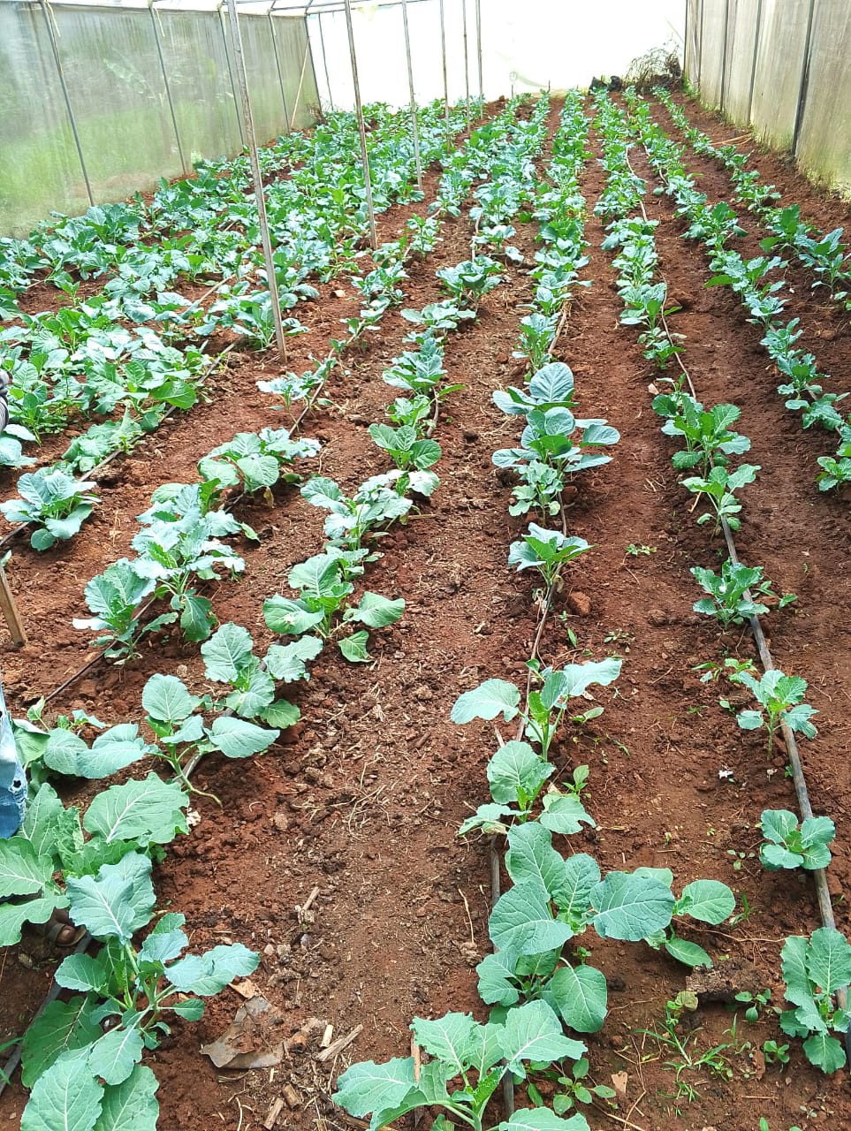
PROBLEM STATEMENT
Resource management problems including water and fertilizers
Difficulty in maintaining optimal conditions for the greenhouse.
Early detection of crop pest and diseases leading to low yields.
Limited technical support since all activities are manual.

Slide 4
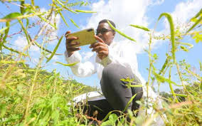
Objectives
Automate greenhouse monitoring and control processes, reduce operational costs.
Enable Real Time Crop Health Monitoring using trained models.
Link farmers and experts through digital connectivity for knowledge sharing.
Provide real time data and alerts.
Improve market access by linking farmers to vendors.

Slide 5
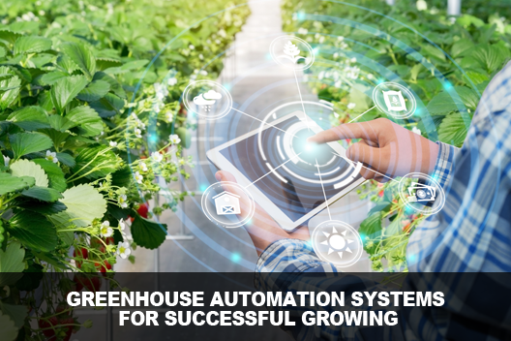
SOLUTION OVERVIEW
A IoT System that detects when the greenhouse conditions surpasses the threshold and automatically switches on the actuators.
An app that helps the farmer to remotely track the state of the greenhouse, upload photos of the diseases and pests, and get quality products directly from producers .

Slide 6
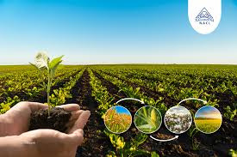
Key features
Crop sustainability: Keep real time data about soil nutrients and pH
Disease/pest upload: Real-time diagnosis and treatment suggestions.
Event management: Track and schedule crop events and growth
Farm product supply: Connect farmer to the vendors to obtain quality seeds and fertilizers

Slide 7
Solution
Farmer and expert
Vendor
Registration
Log-in
dashboard
register
login
Dashboard
Get recommendations/solution
AI
chatbot
Device
control
Track deliveries
Upload products
Shop
Become an expert
Profile/
Log out

Slide 8
Why KiliMboga?
 | Kilimboga | Tumaini | Farmable
Pest & disease identification | ✔ | ✔ | x
Crop Analysis | ✔ | x | x
Nutrients analysis | ✔ | x | x
Automated irrigation | ✔ | x | x
Temperature regulation | ✔ | x | x

Slide 9
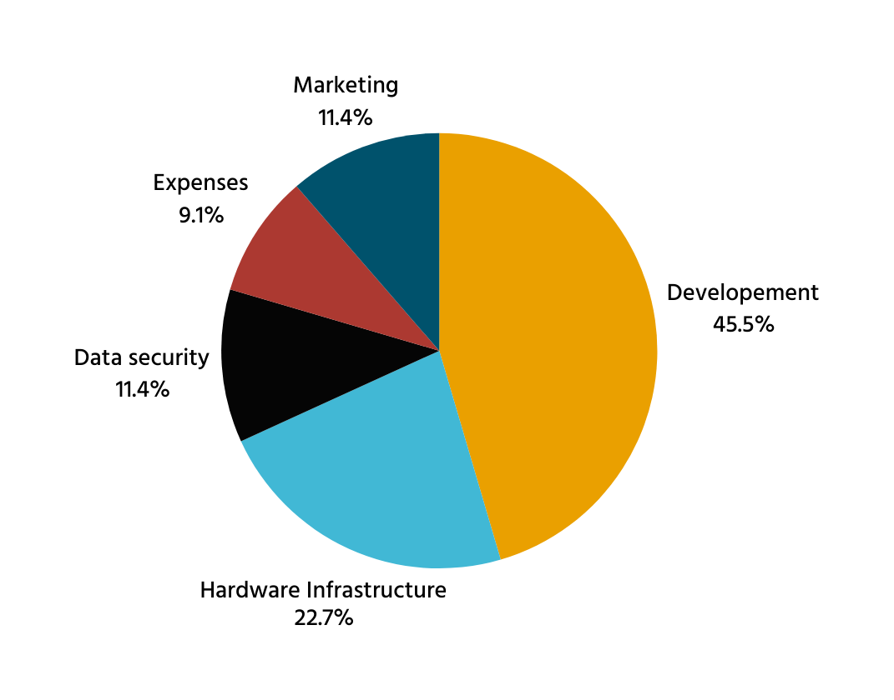
Build Ask
KES 350,000

Slide 10
Demo
KiliMboga Vendor

Slide 11
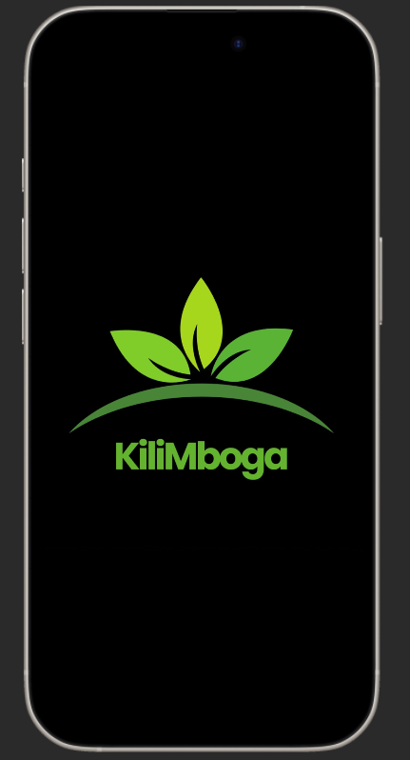
CONCLUSION
Empowering farmers with innovative technology to transform agriculture.

Slide 12

Team
Byrone Kingsly
Mobile/Full-Stack Engineer
Antony Kariuki
Backend/DevOps Engineer
Victor Wanyungu
Full-Stack Engineer
Faith Nduku
UI/UX Designer/Frontend Engineer
Sebastian Chanzu
IoT Expert/Machine Learning Engineer

Slide 13
KiliMboga
The perfect solution to all farmers

